Slide 1
The Solar System… in your pocket!
How big the planets are? How far from each other?

Slide 2
The Sun
In the centre of the Solar System there is the Sun, the closest star to us.
Thanks to its gravity, it keeps all the planets on their orbits.
It has 99.8% of the whole Solar System mass.
Main facts:
Mass of 2'000'000'000'000'000'000'000'000'000'000 kg
Radius of 695’000 km
Temperature of:
5800 K on the surface
15'000'000 K in the nucleus, where the thermonuclear reactions occur which generate the heat and light that we feel

Slide 3
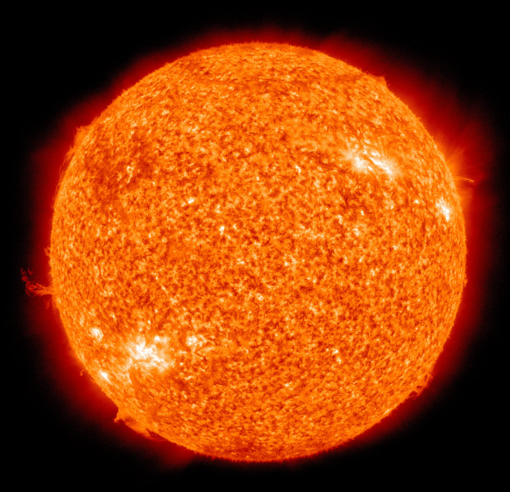
The Sun… in your pocket
To reduce the Sun and the planets to the size of your pockets (more or less…) we are going to use a scale factor of 1:5’000’000’000.
If the Sun was 5 billion times smaller than its actual size it would be as large as…

Slide 4
Mercury
It is the closest planet to the Sun.
It is a small rocky planet without atmosphere, which causes very large temperature variation between day and night.
Main facts:
Radius of 2'440 km
The year is 88 earth days long
The day is 59 earth days long
Temperature of:
100 K during the night (about -170°C)
700 K during the day (about 400°C)

Slide 5
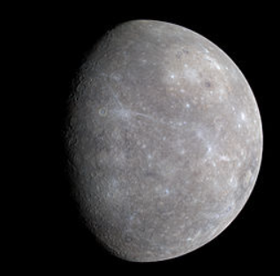
Mercury… in your pocket
If Mercury was 5 billion times smaller than its actual size it would be as large as…
1 mm

Slide 6
Venus
It is the brightest planet in the night sky.
It is covered by a thick layer of clouds which prevents most of the solar light to reach the planetary surface.
It is the hottest planet due to the greenhouse effect caused by the very dense atmosphere.
The atmospheric pressure is 92 times higher than on Earth.
Main facts:
Radius of 6'051 km
Temperature of 740K (about 470°C)

Slide 7
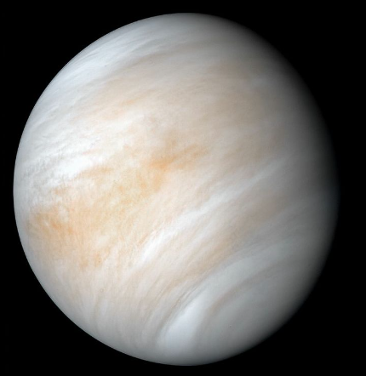
Venus… in your pocket
If Venus was 5 billion times smaller than its actual size it would be as large as…
2.4 mm

Slide 8
Earth
It is the planet where we all live!
It has oceans of liquid water and an atmosphere not too dense to block the solar light (even when it is cloudy) but still dense enough to contain enough elements useful for life (especially oxygen).
Main facts:
Radius of 6’371 km
Temperature of 290K (about 15°C on average)

Slide 9
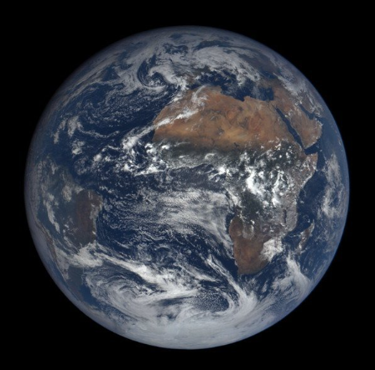
Earth… in your pocket
If the Earth was 5 billion times smaller than its actual size it would be as large as…
2.5 mm

Slide 10
Mars
It is the closest planet to Earth, about half the size of Earth.
Mars atmosphere is not too far from Earth’s and could host forms of life similar to what we know on Earth (bacteria?).
It is the only other planet where there is abudance of water (most ice under the surface).
Main facts:
Radius of 3’390 km
Temperature of 210K (about -63°C on average. can reach 20°C at midday on Summer)
Mount Olympus is the highest volcano in the Solar System (three times higher than the Mount Everest).

Slide 11
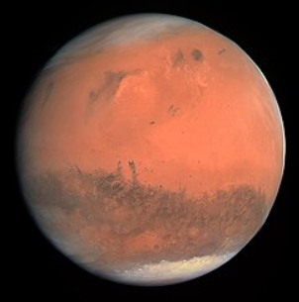
Mars… in your pocket
If Mars was 5 billion times smaller than its actual size it would be as large as…
1.4 mm

Slide 12
Jupiter
It is the largest planet of the Solar System.
It has no solid surface, it is made only by gas (mainly hydrogen and helium).
It has intense atmospheric activity. There is a giant storm which is called the Great Red Spot and it is known to be there since 400 years!
Main facts:
Radius of 69’911 km
Temperature of 130K (about -145°C)
95 natural satellites
Highest rotational speed: the day is only 9.5 hours long

Slide 13
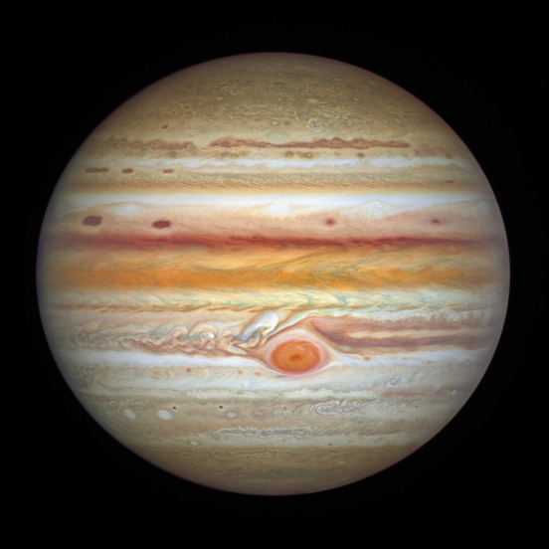
Jupiter… in your pocket
If Jupiter was 5 billion times smaller than its actual size it would be as large as…
28 mm (not in scale with the previous planets since slide is not large enough!)

Slide 14
Saturn
It is very famous for its rings, firstly observed by G. Galilei, then recognized by G. Cassini (XVII century). Each ring is actually kind of a cloud of small icy rocks, each of them is a small satellite of Saturn.
It has no solid surface, it is made only by gas (mainly hydrogen and helium).
Main facts:
Radius of 58’232 km
Temperature of 93K (about -180°C)
146 natural satellites (in addition to the rings)

Slide 15
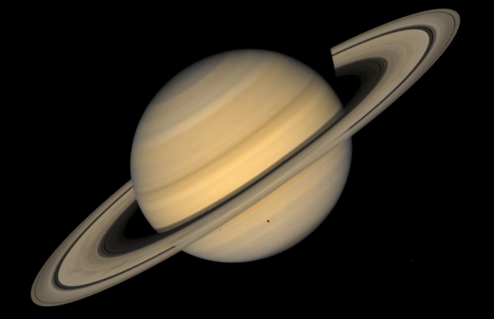
Saturn… in your pocket
If Saturn was 5 billion times smaller than its actual size it would be as large as…
23 mm (not in scale with the previous planets since slide is not large enough!)

Slide 16
Uranus
Its atmosphere is mainly composed by hydrogen and helium, with an inner layer of ice (water and methane).
It has no solid surface, its nucleus is constituted by gas made liquid by the strong pressure.
It is the only planet whose rotational axis is almost parallel to its orbital plane (instead of «spinning» like the other planets, it «rolls» around its orbit).
As Saturn, it also has rings although they are much thinner and mainly visible in infrared light.
Main facts:
Radius of 25’362 km
Temperature of 53K (about -220°C)

Slide 17
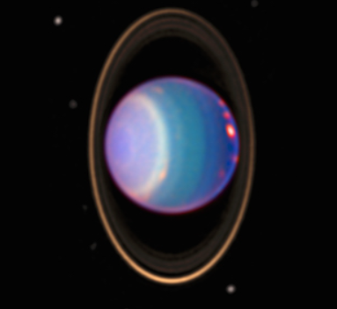
Uranus… in your pocket
If Uranus was 5 billion times smaller than its actual size it would be as large as…
10 mm

Slide 18
Neptune
Its atmosphere is mainly made by hydrogen and helium. with an inner layer of ice (water and methane).
It has the stongest winds in the Solar System, speed up to 2100km/h has been measured.
It has no solid surface, its nucleus may be constituted by gas made liquid by the strong pressure.
As Saturn. it also has one very weak ring.
Main facts:
Radius of 24’622 km
Temperature of 50K (about -223°C)

Slide 19
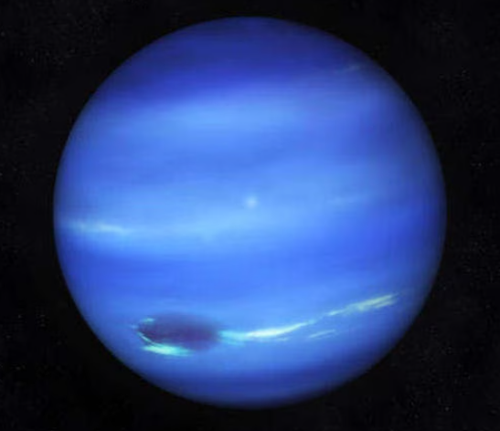
Neptune… in your pocket
If Neptune was 5 billion times smaller than its actual size it would be as large as…
9.8 mm

Slide 20
How far the planets are?
Astronomers use a strange unit to measure distances in the Solar System: the Astronomical Unit (A.U.). This unit is not included in the International System, but it is still very common since it allows to use small numbers to express very large distances.
1 A.U = 150’000’000 km
Planet | Distance from the Sun (A.U.)
Mercury | 0.39
Venus | 0.72
Earth | 1
Mars | 1.5
Jupiter | 5.2
Saturn | 9.5
Uranus | 19
Neptune | 30

Slide 21
The Solar System… in your pocket?
Using the same scale 1:5’000’000’000 to build a model of the whole Solar System Neptune would be almost 1 km far from the Sun (!)
Still too large. We need a much larger pocket or a smaller scale… or both
Planet | 1:5’000’000’000 scale distance from the Sun (m)
Mercury | 12
Venus | 22
Earth | 30
Mars | 46
Jupiter | 156
Saturn | 286
Uranus | 576
Neptune | 903

Slide 22
Well: Solar System… in this room!
The room where we are is 7 m long.
To fit the distance from Neptune to the Sun in the room we need to use a 1:650’000’000’000 scale (130 times smaller than the previous scale used for the planets’ size).
Using this scale we can fit the whole Solar System in this room.
Planet | 1:650’000’000’000 scale distance from the Sun (m)
Mercury | 0.09
Venus | 0.17
Earth | 0.23
Mars | 0.35
Jupiter | 1.21
Saturn | 2.22
Uranus | 4,47
Neptune | 7.00

Slide 23
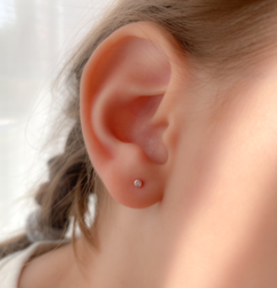
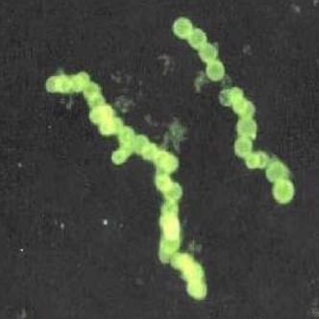
But…
To fit the Solar System in the room AND to represent planets’ size with the same scale of 1:650’000’000’000 the Sun would be only 2 mm large and Mercury would be only 7 microns large (!)

Slide 24
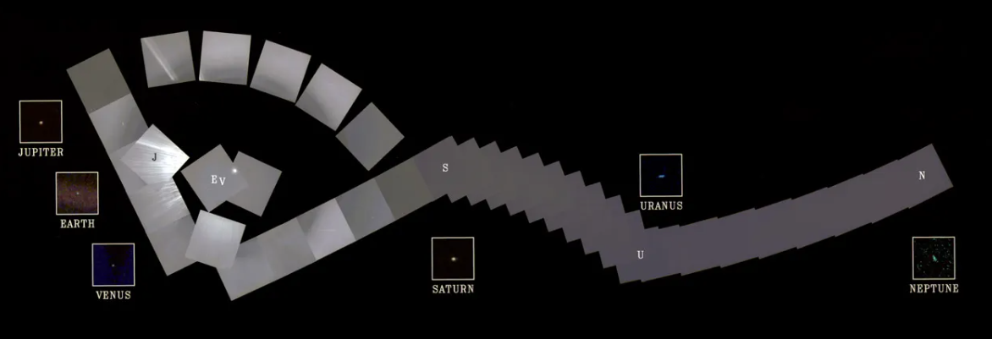
Thank you for your attention!

